Slide 1
4:7-18

Slide 2
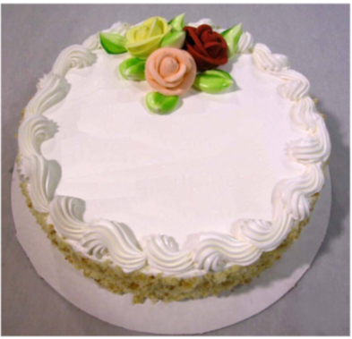
4:7-18
1
John 4:18
“… for you have had five husbands, and the man you have now is not your husband."
“There is no fear in love; but perfect love casts out fear…”

Slide 3
4:7-18

Slide 4
4:7-18
Love ~ agapaō – 18x in chapter 4
Chapter 1, koinonia – love through fellowship
Chapter 2, ginōskō and oida – love through knowledge
Chapter 3, menō – love through abiding

Slide 5
4:7-18
The four loves
Storgē
– family love
Eros
because of
– not sexual love, but sensual love
Philos
– friendly love
– selfless love
Agapaō
– because

Slide 6
4:7-18

Slide 7
4:7-18
Blaise Pascal ~ “Human things must be known to be loved; divine things must be loved to be known.”
Phillip Yancey ~ “Sociologists have a theory of the looking-glass self: you become what the most important person in your life (wife, father, boss, etc.) thinks you are. How would my life change if I truly believed the Bible’s astounding words about God's love for me, if I looked in the mirror and saw what God sees.”

Slide 8
4:7-18

Slide 9
4:7-18
1 Pet. 4:8-10 ~ ⁸ And above all things have fervent love for one another, for “love will cover a multitude of sins.” ⁹ Be hospitable to one another without grumbling. ¹⁰ As each one has received a gift, minister it to one another, as good stewards of the manifold grace of God.
Gift ~ charisma – grace gift, or a thing of grace

Slide 10
4:7-18

Slide 11
4:7-18

Slide 12
4:7-18
John 13:15 ~ If I then, your Lord and Teacher, have washed your feet, you also ought to wash one another’s feet.

Slide 13
4:7-18

Slide 14
4:7-18
Perfected ~ teleioō – to fill, to bring to completion, to consummate
David Guzik ~ “The mature Christian will be marked by love. Again, the true measure of maturity is not the image of power, or popularity, or passionate feelings – but the abiding presence of God’s love in our lives, given out to others.”

Slide 15
4:7-18

Slide 16
4:7-18
1 Cor. 13:1 ~ Though I speak with the tongues of men and of angels, but have not love, I have become sounding brass or a clanging cymbal.
Merrihew Standard Version ~ If I could speak with the greatest of all oratorical skills or use an ecstatic language fit for heaven itself but was not selfless in my thoughts, words and deeds, those words would only amount to a cacophonous commotion or a raucous racket.

Slide 17
4:7-18

Slide 18
4:7-18
Philips ~ … for fear always contains some of the torture of feeling guilty.
C. H. Spurgeon ~ “Our lusts are cords that bind us. Fiery trials are sent to burn and consume them. Who fears the flame which will bring him liberty from intolerable bonds?”

Slide 19
4:7-18

Slide 20
4:7-18
Why we fear love …
Self
- pity (I’ve been wounded before)
Self
Self
- protection (someone might take advantage)
Self
- promotion (I want to appear more spiritual)

Slide 21
4:7-18

